Slide 1

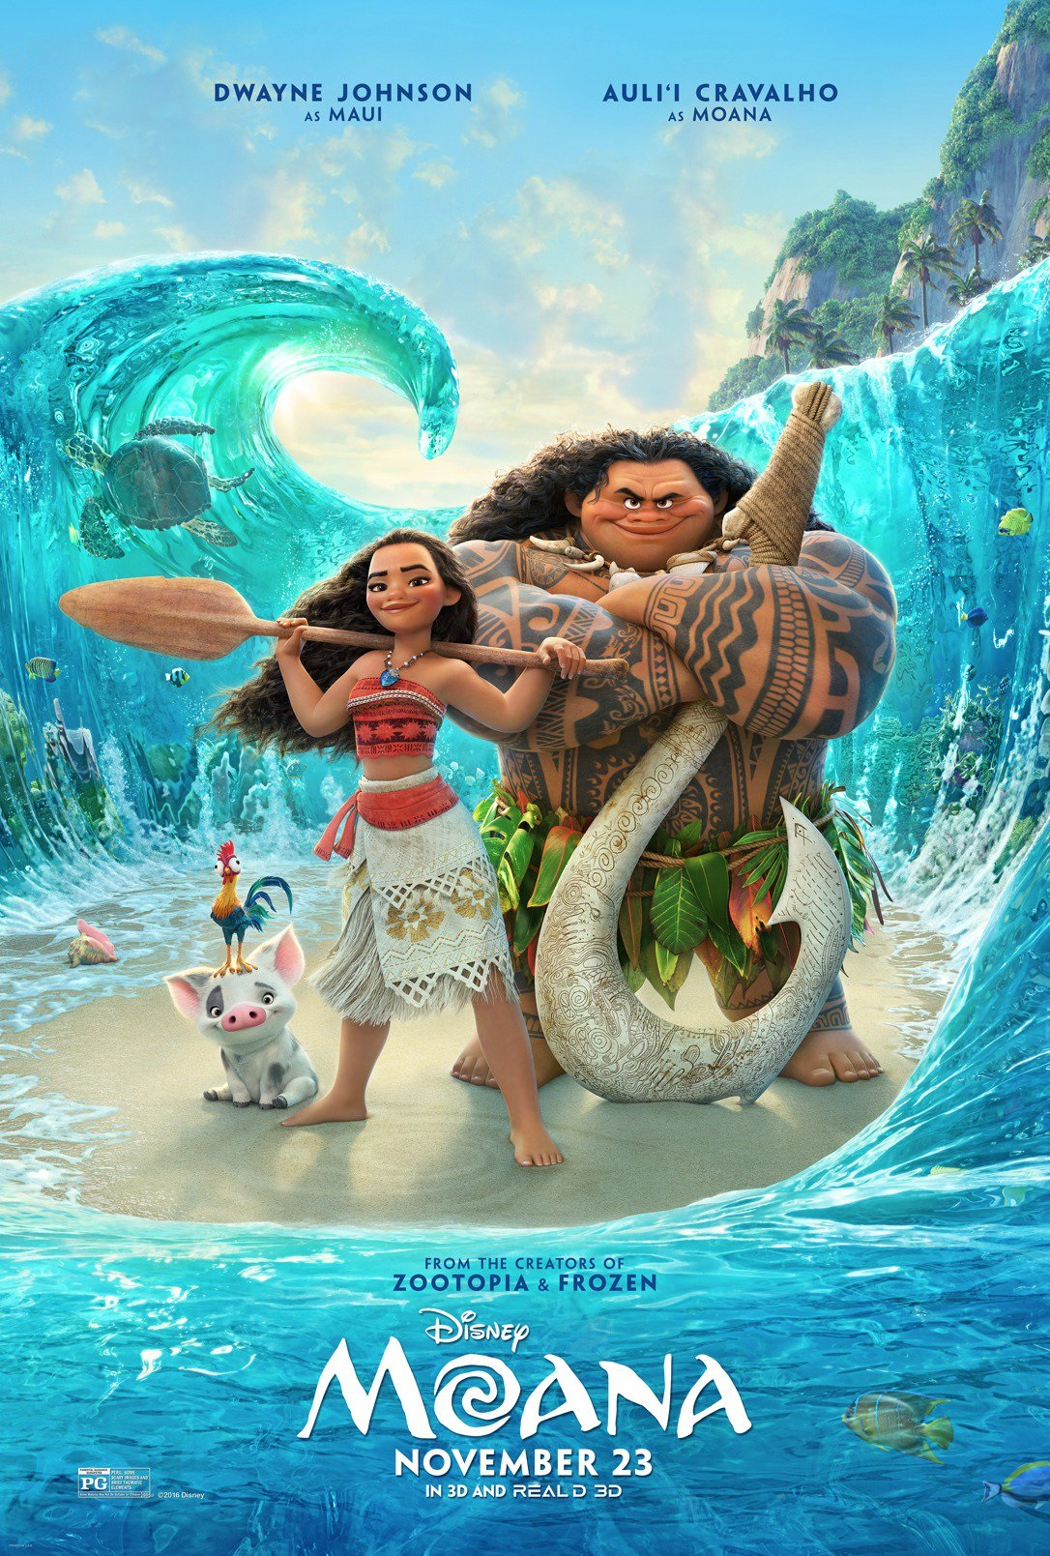
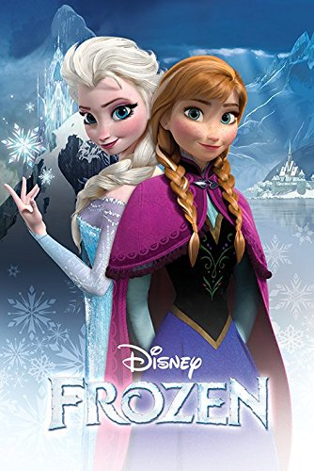
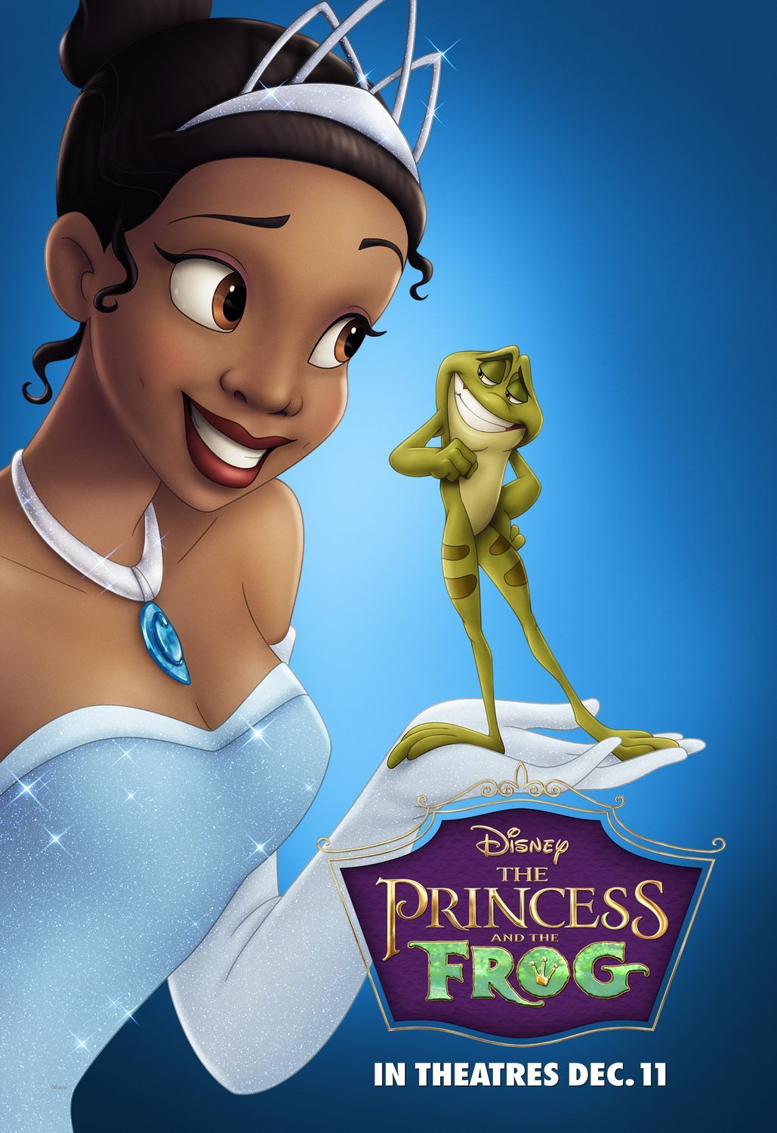

Slide 2
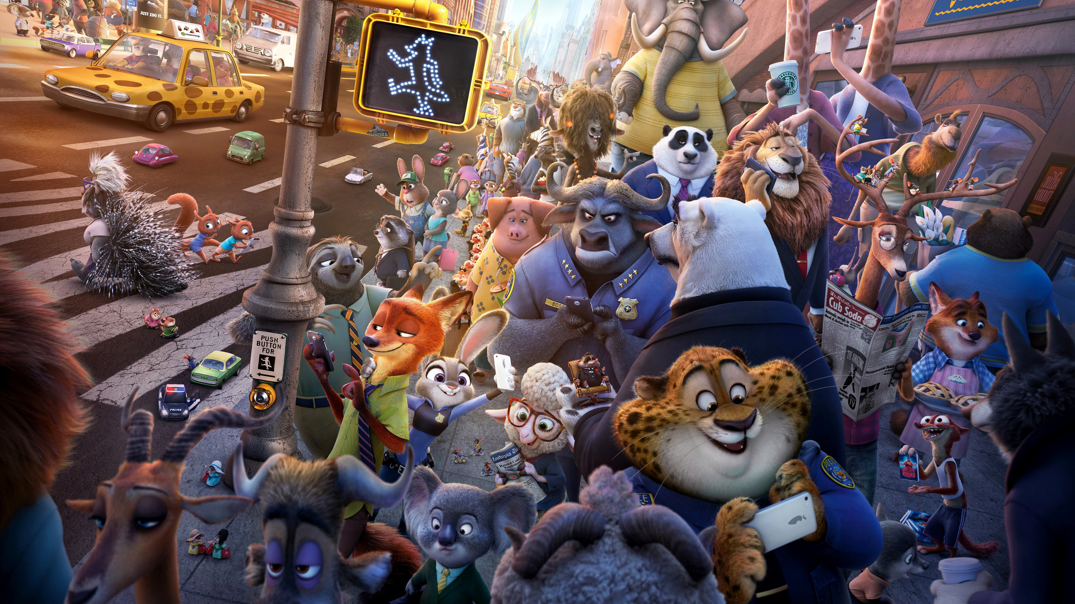

Social Prejudice and Racism

Slide 3
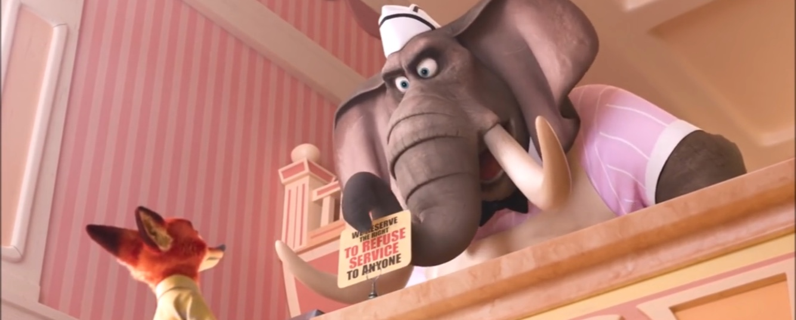
Scenes with Discrimination
“We reserve the right to refuse service to anyone.”

Slide 4


Scenes with Discrimination
X

Slide 5
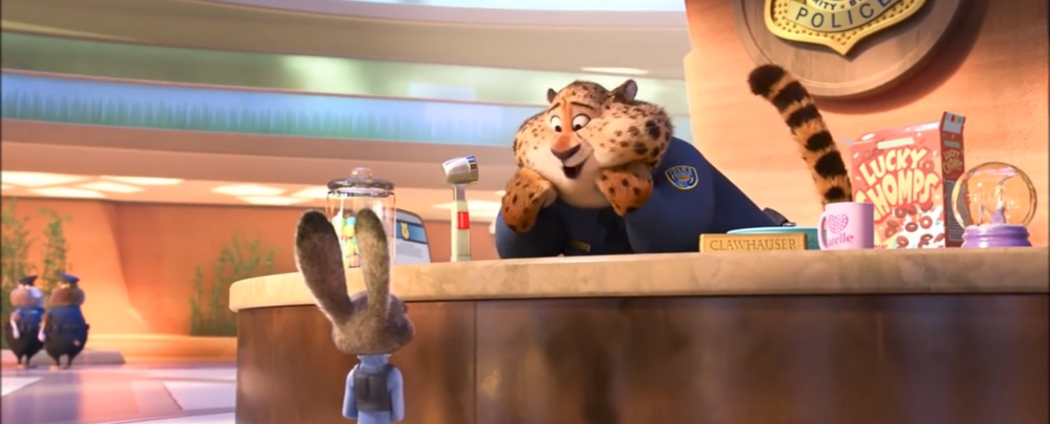
Scenes with Discrimination
“You probably didn't know, but a bunny can call another bunny 'cute', but when other animals do it, that's a little...”

Slide 6
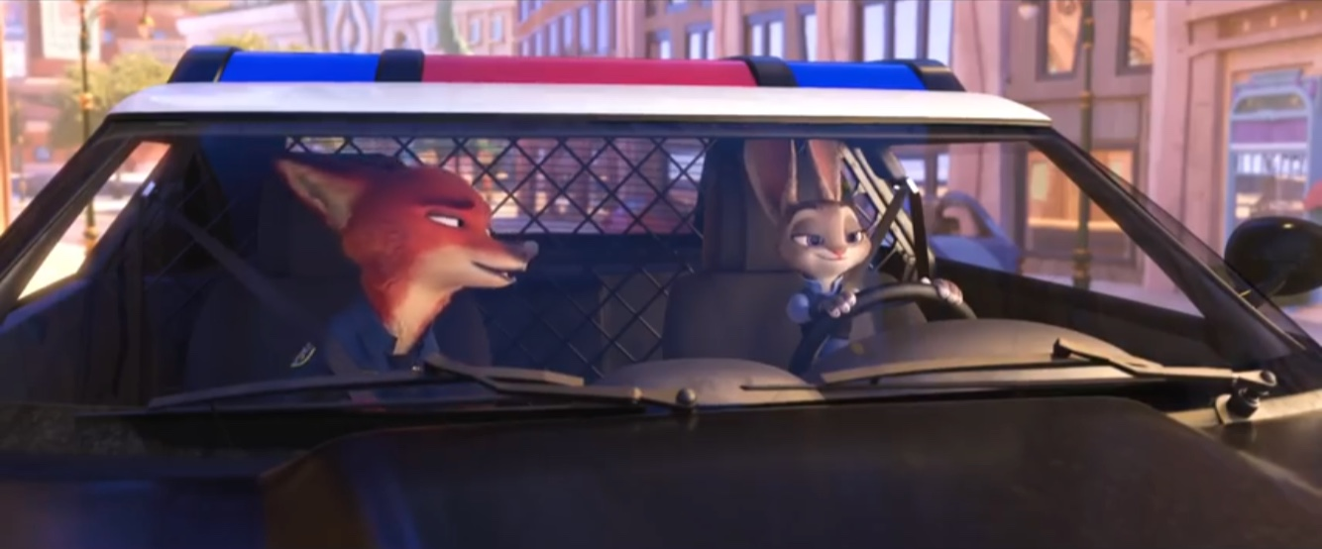
Scenes with Discrimination
X
“Sly bunny” “Dumb fox”

Slide 7
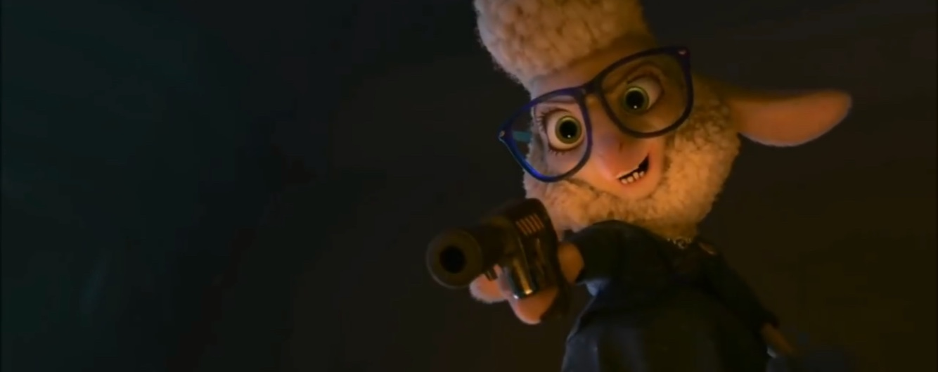
Historical References
“Fear always works.”
Reference) https://www.ranker.com/list/zootopia-addresses-racism-v1/erik-barnes

Slide 8

Eutopia?
!

Slide 9
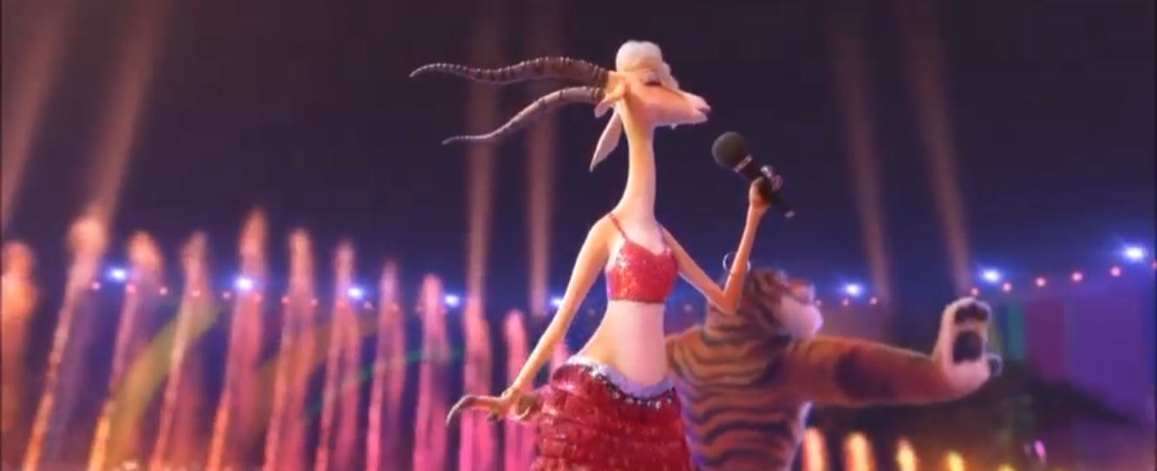
Gazelle’s Song

Slide 10
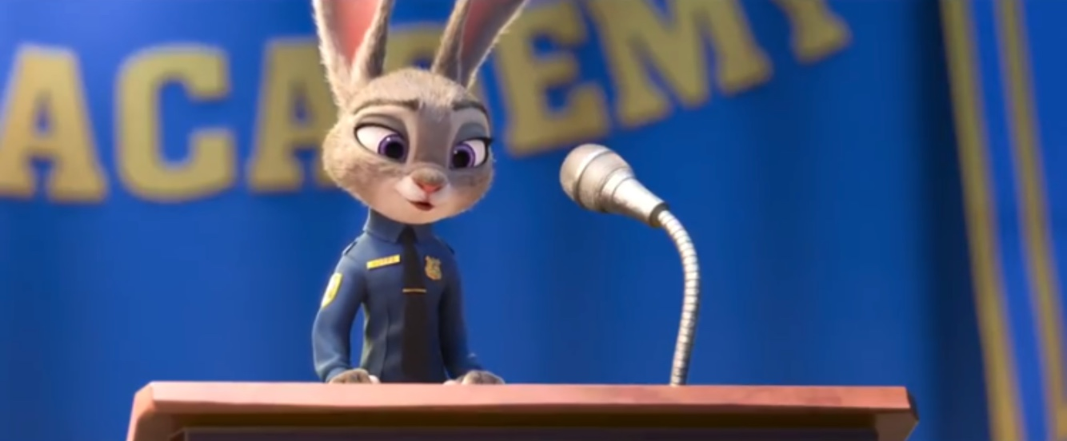
“We all have limitations. We all make mistakes. …And the more we try to understand one another. The more exceptional each of us will be. But we have to try. So no matter what type of animal you are. …I implore you. …Try to make the world a better place.”

Slide 11
:Where Anyone Can Be Anything

